Slide 1
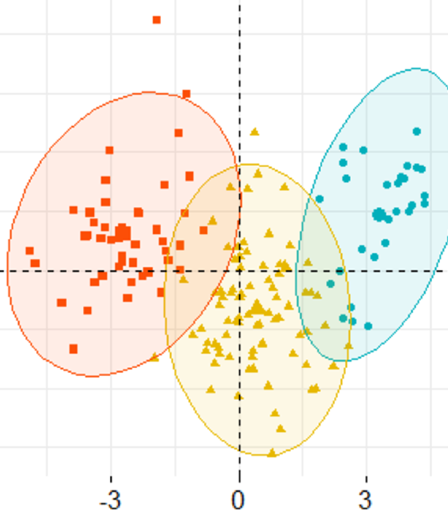
Dimension Reduction
Principal Component Analysis
&
Singular Value Decomposition

Slide 2

Dimension Reduction
Principal Component Analysis (PCA)
Singular Value Decomposition (SVD)

Slide 3
Dimension Reduction- Applications
Face Recognition
Computational Performance
Image Compression

Slide 4
PCA- Benefits
Reduce the number of columns
Identify the relation between the columns
Visualize multidimensional data in 2D

Slide 5
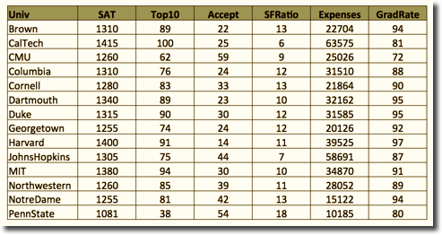
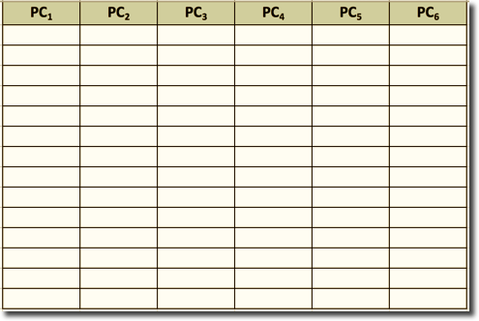
PCA Benefits

Slide 6
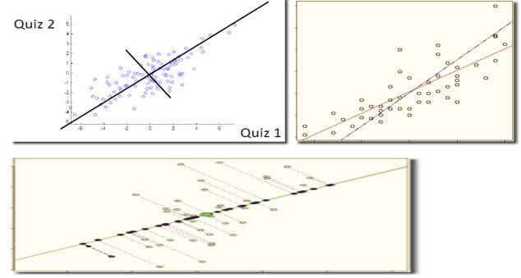
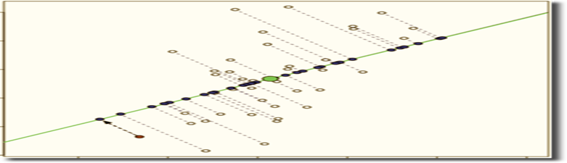
PCA Intuition

Slide 7
PCA Preliminaries
Input (Before PCA) n’ original columns | Output (After PCA) n’ principal components (‘n’ weighted averages of original measurements)
Input (Before PCA) Correlated | Output (After PCA) Uncorrelated Ordered by variance Keep top principal components; drop rest
PCA

Slide 8
PCA Weights
The i^{th} principal component is a weighted average of original measurements / columns:
PC_{i} = a_{i1}X₁+ a_{i2} X₂+…..+ a_{ip}X_{p}
Weights (a_{ij}) are chosen such that:
PCs are ordered by their variance (PC₁ has largest variance, followed by PC₂, PC₃, and so on)
Pairs of PCs have correlation = 0
For each PC, sum of squared weights = 1 (Unit Vector)

Slide 9
PCA Weights
PC_{i} = a_{i1}X₁ + a_{i2}X₂ + a_{i3}X₃…. + a_{in}X_{n}
Main idea: High variance = lots of information
Var (PC_{i}) = a²_{i1} Var(X₁) + a²_{i2} Var(X₂) + a²_{i3} Var(X₃) + … + a²_{in} Var(X_{n}) + 2a_{i1}a_{i2} Cov(X_{1,} X₂) + … + 2a_{in-1}a_{in} Cov(X_{n-1,} X_{n})
Also, Covar(PC_{i} , PC_{j}) = 0, when i ≠ j
Goal 1: Find weights a_{ij} that maximize variance of PC_{i}, while keeping PC_{i} uncorrelated to other PCs
The covariance matrix of the Xs is needed
PCs are uncorrelated
Var(PC₁) > Var(PC₂) > Var(PC₃) > Var(PC₄) >…..........

Slide 10
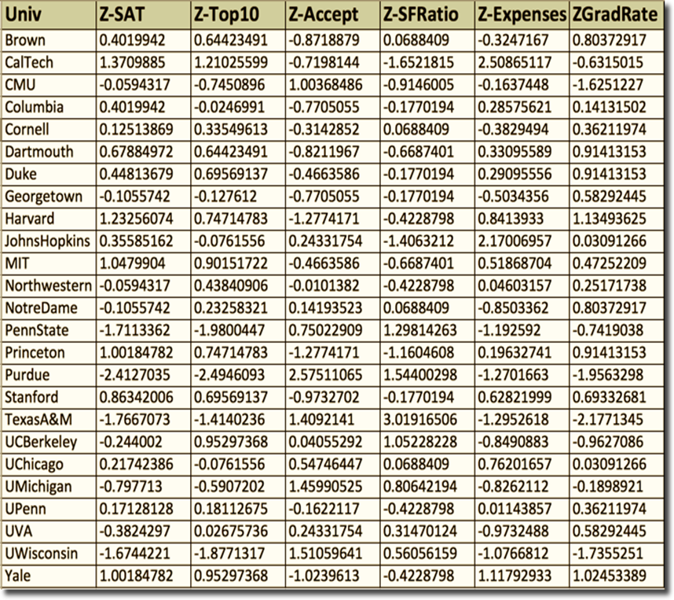
Standardize the variables
We standardize because variables with large variances will have bigger influence on result
We standardize before applying PCA
Correlation matrix is the matrix which standardizes the data before finding the correlation values
Covariance matrix is the matrix, which does not standardize the data before finding the correlation values

Slide 11
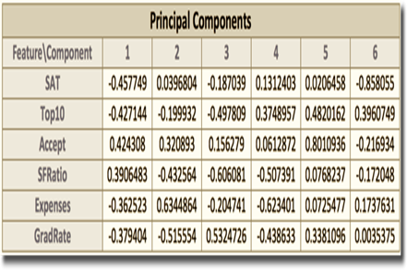
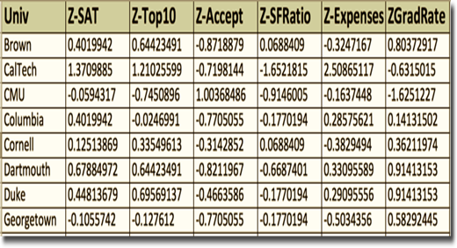
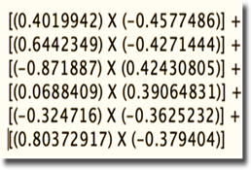
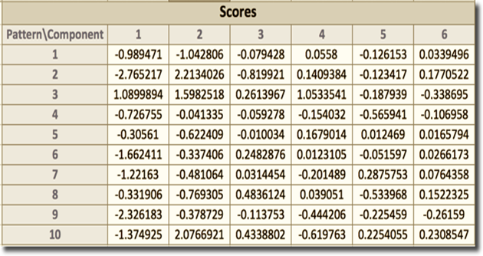

PCA Calculation

Slide 12
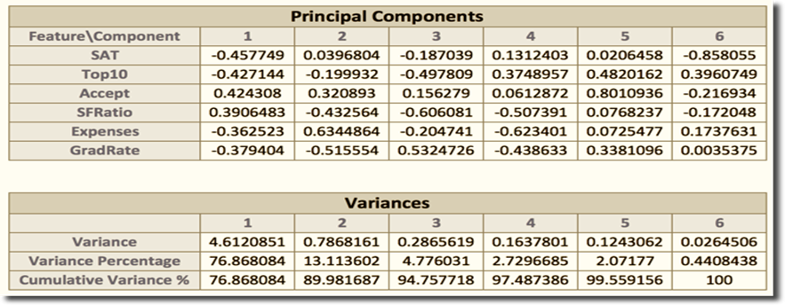
PCA Goal 1 – Data Reduction
PCs are ordered by variance
PC1 captures 76.86% of the information
First 2 PCs capture 89.98% of the information
Choose first few PCs & drop the rest

Slide 13
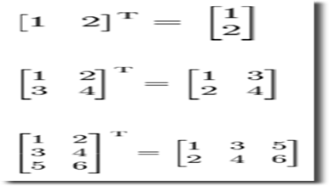
PCA Goal 1 – Data Compression – Matrix Basics

Slide 14
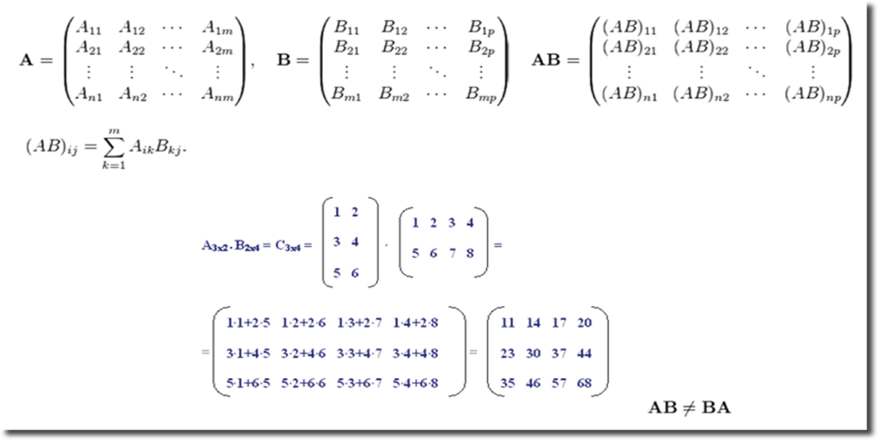
PCA Goal 1 – Data Compression – Matrix Basics

Slide 15
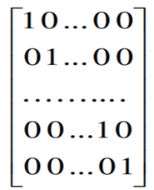
PCA Goal 1 – Data Compression – Matrix Basics
If A x B = I, identity matrix then B = A-1
Identity Matrix:

Slide 16
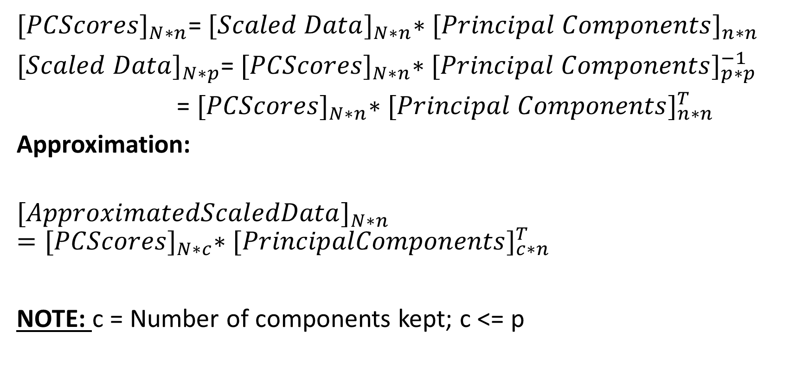
PCA Goal 1 – Data Compression
${[PCScores]}_{N∗n}$= ${[Scaled Data]}_{N∗n}∗{[Principal Components]}_{n∗n}$
${[Scaled Data]}_{N∗p}$= ${[PCScores]}_{N∗n}∗{[Principal Components]}_{p∗p}^{−1}$
= ${[PCScores]}_{N∗n}∗{[Principal Components]}_{n∗n}^{T}$
Approximation:
$${[ApproximatedScaledData]}_{N∗n}={[PCScores]}_{N∗c}∗{[PrincipalComponents]}_{c∗n}^{T}$$
NOTE: c = Number of components kept; c <= p

Slide 17
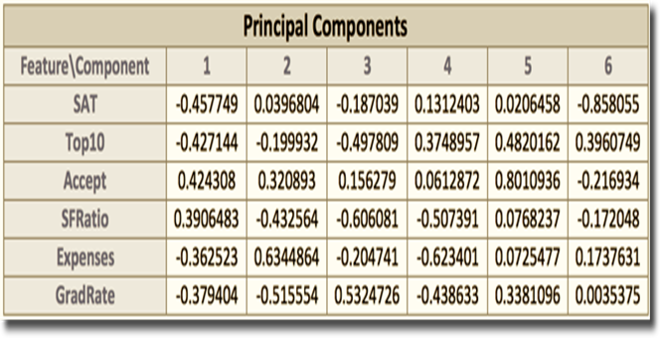

PCA Goal 2 – Labeling PCs
Learn relationships with PCA by interpreting the weights:
$a_{i1}$,…, $a_{ip}$ are the coefficients for ${PC}_{i}$.
They describe the role of original X variables in computing ${PC}_{i}$.
Useful in providing context-specific interpretation of each PC.
PC₁ weights measure the degree of:
High: Accept, SFRatio
Low: Expenses, GradRate, SAT, Top10

Slide 18
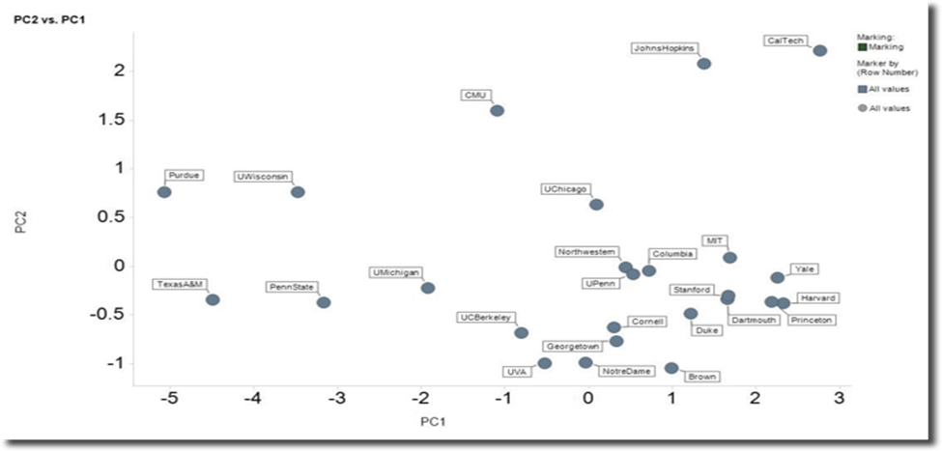
PCA Goal 3 – PCA for visualization
The first 2 or 3 PCs can be used to project data from an n-dimensional space onto a 2D or 3D space

Slide 19
PCA – Additional Benefits
Monitoring batch processes:
Multivariate data at different time points
Historical database of successful batches are used
Multivariate trajectory data is projected to low-dimensional space i.e., Simple monitoring charts to spot outlier

Slide 20


SVD – Singular Value Decomposition
Original size = 147,456 bytes
Compressed size = 15,380 bytes

Slide 21
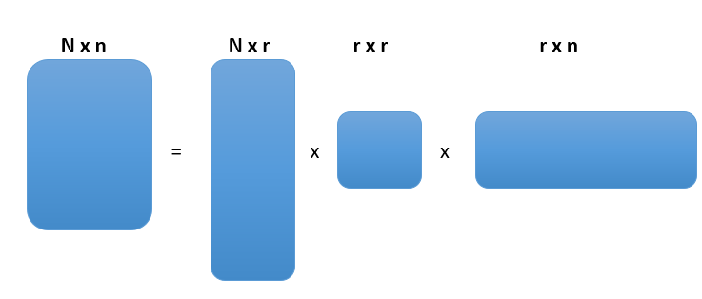
SVD – Preliminaries
X = UΣV^{T}
U & V are Orthonormal matrices
Orthonormal = Orthogonal + Unit Length (Normalize + Sum)

Slide 22
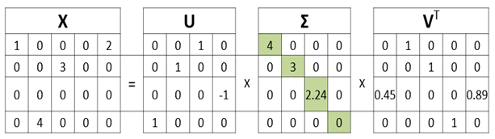

SVD
X^{k} = $\sum_{i=1}^{k}{U}$_{i} $\sum_{i}{V}$_{i}^{T}
Each term in the summation expression provided above is called Principle Image

Slide 23
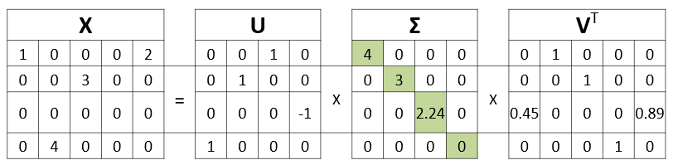
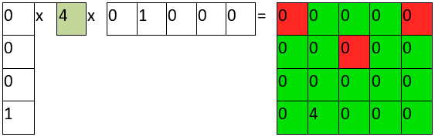
SVD
Original Size = 4*5 = 20 bytes
k = 1
Compressed Size = 4*1 + 1 + 1*5 = 10 bytes

Slide 24
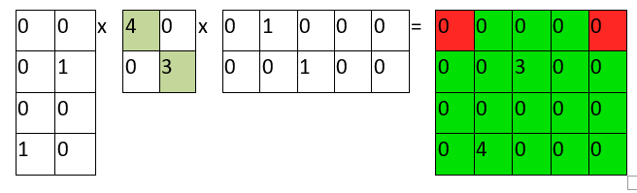
SVD
Compressed Size = 4*2 + 2 + 2*5 = 20 bytes
Original size = 384*384 bytes = 147,456 bytes
• k=1: 384*1+1+1*384=769 bytes
• k=10: 384*10+10+10*384=7,690 bytes
• k=20: 384*20+20+20*384=15,380 bytes
• k=50: 384*50+50+50*384=38,450 bytes
• k=100: 384*100+100+100*384=76,900 bytes
• k=200: 384*200+200+200*384=153,800 bytes

Slide 25
NEXT TOPIC> ASSOCIATION RULES

